Slide 1
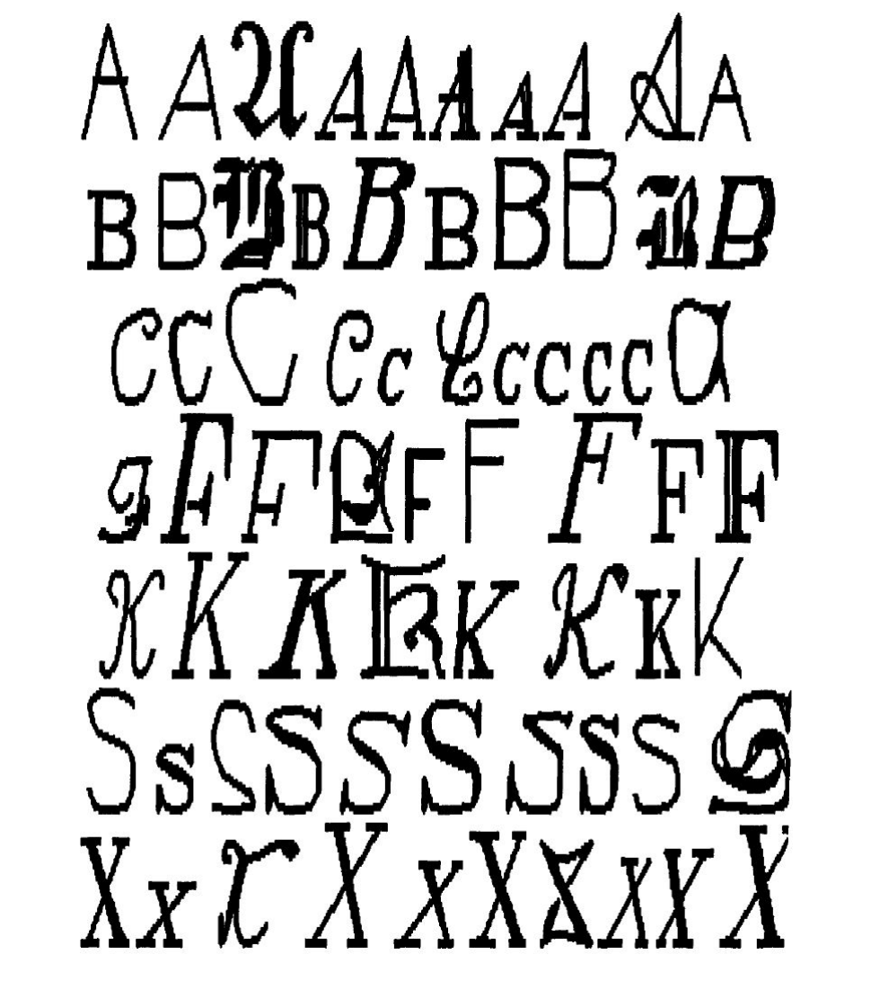
IE 6600 Final Presentation
Classification on the UCI Letter Recognition Dataset

Slide 2

Overall
Letter recognition is often considered a great problem to demonstrate the power of machine learning classification, primarily because it is an elegant example where simple machine learning models perform well. This is largely due to the use of very clean and homogeneous data. However, when using more complex data, this can become a quite challenging problem. In my report, we will examine an example of precisely that.
The "Letters Recognition Dataset" from the UCI machine learning repository contains summary statistics (derived from image analysis) of randomly distorted English letters in 20 different fonts. This data was originally created to train Holland-style classifiers in a 1991 paper by Frey and Slate.

Slide 3

Problem Statement
I’m going to apply different machine learning models to the Letter Recognition Data Set in my project. By testing different models to the data set, I can find out which model applies to this data set best. I’ll split the data set into training data set and test data set: 16000 for training data set and 4000 for test data set. Then build a variety of classification models (such as SVC, Decision Tree, KNN models) using the training data set, and use the test data set to measure the performance of the models in order to pick the best model. By classify these 20000 unique stimuli from 20 different fonts, we can better distinguish the 26 capital letters in the English alphabet.

Slide 4

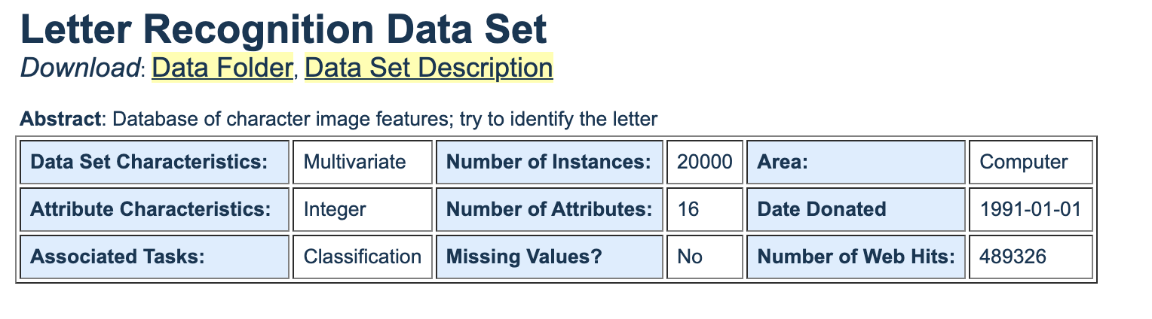
Dataset Introduction

Slide 5
Dataset Introduction
→ Character images based on 20 different fonts
→ Each letter was randomly distorted to produce a
file of 20,000 unique stimuli
→ Statistical moments and edge counts, scaled to
fit into a range of integer values from 0 through 15
→ Attributes: 16 | Target: 26 classes
→ Uniform class distribution among 26 letters.

Slide 6
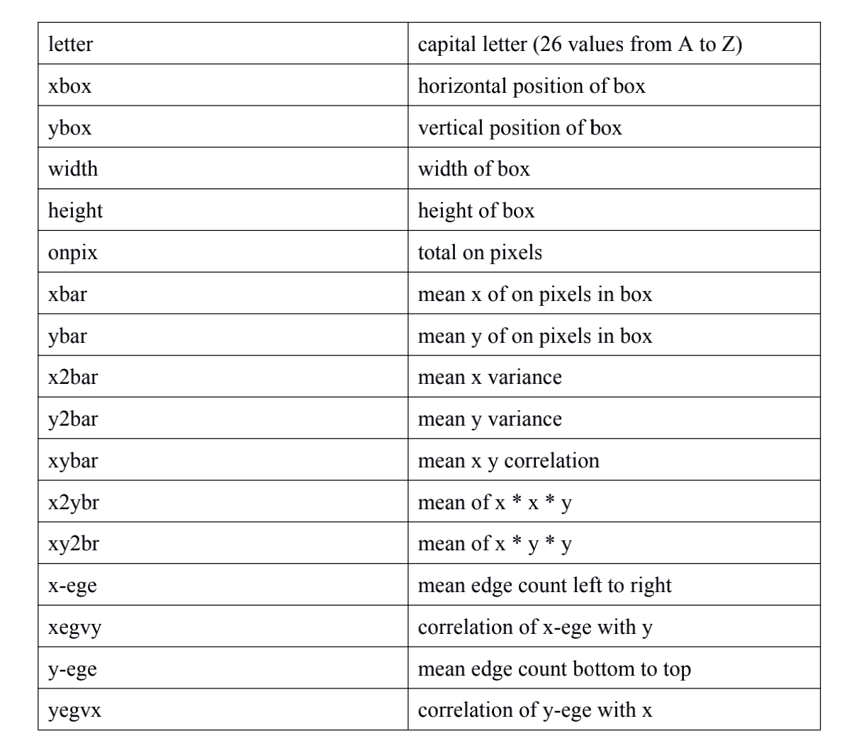
The 16 attributes give information about:
Source: https://archive.ics.uci.edu/ml/datasets/Letter+Recognition

Slide 7
Data Processing
1. Descriptive statistics:
1) Checked the basic information of the data set
2) Found missing values
2. Explanatory Data Analysis (EDA):
1) Calculated the mean of each attribute
2) Sorted the data by attribute 'height’ and showed the top 5 records
3) Calculated the mean of each attribute
4) Found the attribute correlations of the data frame and showed the result in table and heatmap
5) Used histogram to show the distribution of each variable
6) Made 3 bar plots to show the attribute ‘xbox’, ‘height’, and ‘xybar’ of letter a - z

Slide 8
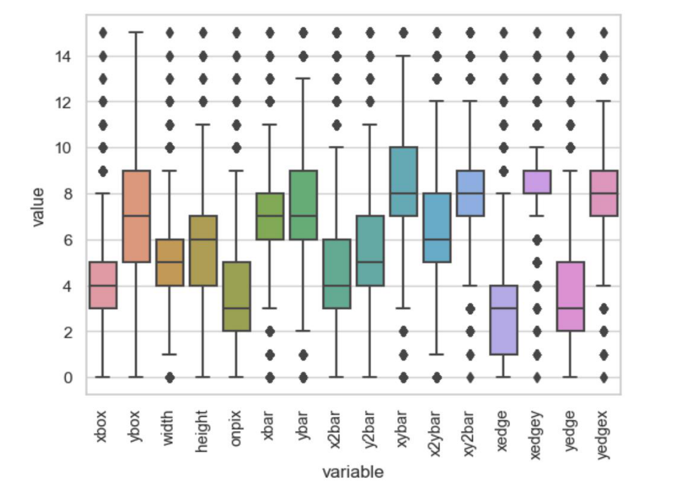
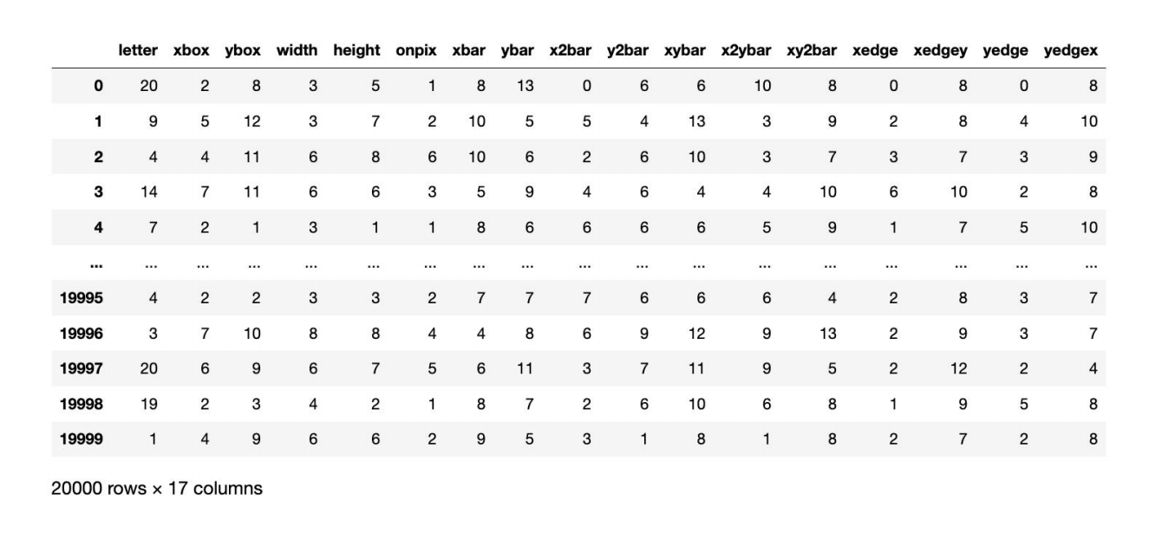
Data Processing
3. Feature engineering
1) Before apply Machine Learning methods, I used number 1-26 to replace the letter from A-Z.
2) Take a look at the outliers

Slide 9
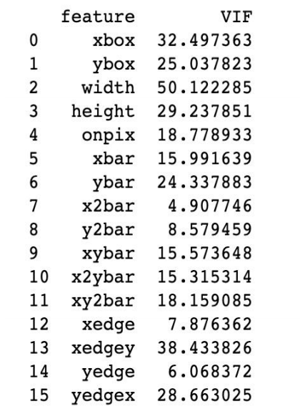
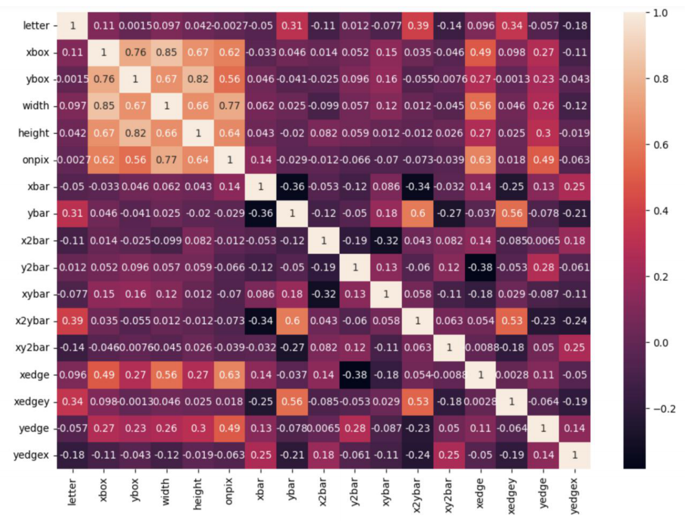
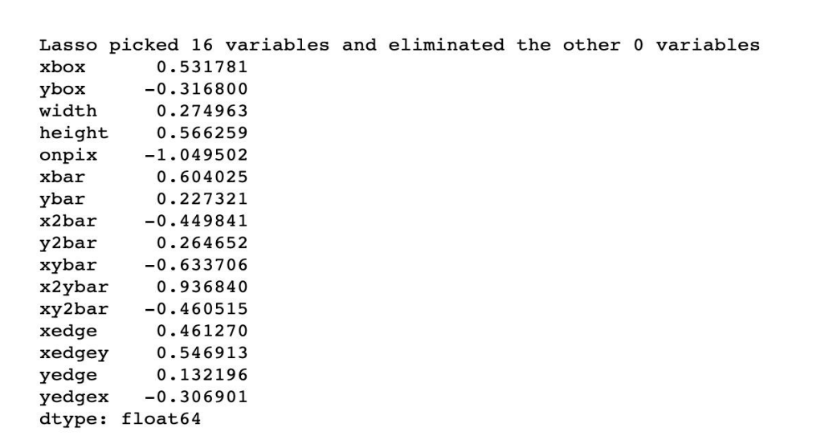
Data Processing
4. Feature selection
Multicollinearity, Correlation analysis, Backward Elimination, Forward feature selection, and Lasso regression
Notes:
From the above analysis we can see that in terms of distinguish the 26 letters, all the 16 attributes ('letter', 'xbox', 'ybox', 'width', 'height', 'onpix', 'xbar','ybar', 'x2bar',
'y2bar', 'xybar', 'x2ybar', 'xy2bar', 'xedge','xedgey', 'yedge', 'yedgex') need to be used.

Slide 10
Modeling and Model Evaluation
Model used:
SVC
Decision Tree
KNN

Slide 11
Modeling and Model Evaluation
SVC
Introduction:
A SVC (Support Vector Classification) model is a type of supervised machine learning model. It is a variant of support vector machines (SVMs) that can be used for classification problems where the number of features is relatively large.
The SVC model works by finding the hyperplane that maximally separates the two classes of data points in the feature space. The data points closest to the hyperplane are called support vectors, and the distance between the hyperplane and the support vectors is called the margin. The goal of the SVC algorithm is to find the hyperplane with the largest margin between the two classes, as this hyperplane is expected to generalize well to new data.
One advantage of the SVC model is its ability to handle high-dimensional data and non-linear decision boundaries. However, a disadvantage of the SVC model is that it can be computationally expensive and may require careful tuning of its hyperparameters.

Slide 12
Modeling and Model Evaluation
SVC
Firstly, I drop the "letter" column from the data frame, resulting in the feature variable X, which includes all independent variables except the label.
Then, I scale the feature variable X using standardization, after that I split the dataset X_scaled and y into training and testing sets in a certain proportion (60% for training, 40% for testing), where the random_state parameter is used to ensure that the random split results are consistent each time.
Then I create a linear SVC model, training the model using the training set, and then making predictions on the testing set. We can take a look at the accuracy of SVC model:
This indicates that the accuracy of SVC model is about 0.85, which is a relatively good score.

Slide 13
Modeling and Model Evaluation
SVC
Model evaluation:
I used classification report to check the model performance. Classification report is a summary of the performance of a classification model on a testing dataset. The function outputs a report that includes the following metrics:
Precision: the ratio of true positive predictions to the total number of positive predictions (TP / (TP + FP))
Recall: the ratio of true positive predictions to the total number of actual positives (TP / (TP + FN))
F1-score: the harmonic mean of precision and recall, which balances the two metrics and is a measure of the model's overall accuracy (2 * (Precision * Recall) / (Precision + Recall))
Support: the number of actual instances in each class

Slide 14
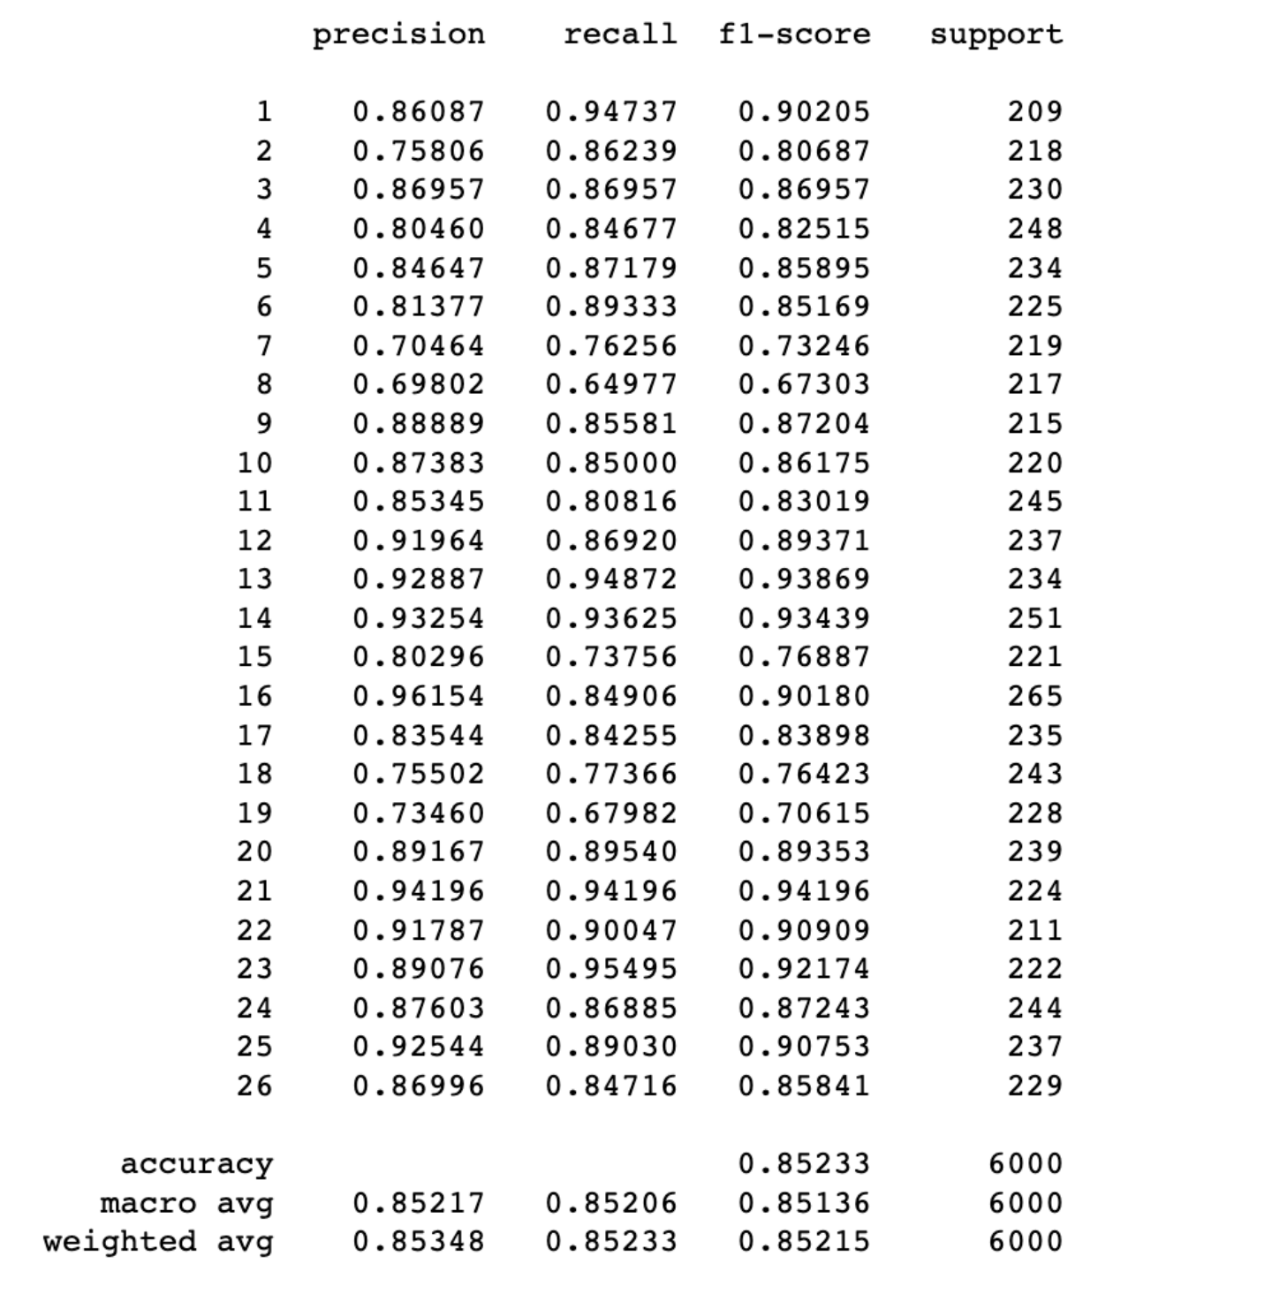
Modeling and Model Evaluation
SVC classification report

Slide 15
Modeling and Model Evaluation
Decision Tree
Introduction:
Decision Tree is a popular machine learning algorithm for classification and regression problems. It works by recursively splitting the dataset into subsets based on the value of a single feature at a time, and constructing a tree-like model that predicts the target variable based on the features.
In a decision tree, the internal nodes represent a decision rule or a feature test, and the edges represent the possible outcomes of the test. The leaves of the tree represent the class labels or the regression values.
To make a prediction on a new data point using a decision tree, we start at the root node and follow the appropriate edge based on the value of the feature being tested at that node. We continue until we reach a leaf node, which gives us the predicted class label or regression value.

Slide 16
Modeling and Model Evaluation
Decision Tree
Firstly, I split the dataset into training and test sets in a certain proportion (40% for testing, 60% for training), where the random_state parameter is used to ensure that the random split results are consistent each time. Then I created the Decision Tree Classifier, trained the model using the training dataset and predict the responses for test dataset.
We can take a look at the accuracy of Decision Tree model:
This indicates that the accuracy of Decision Tree model is 1.0, which means it successfully predicts all the letters and it is a perfect model. We can also check the confusion matrix.
Notes:
confusion matrix

Slide 17
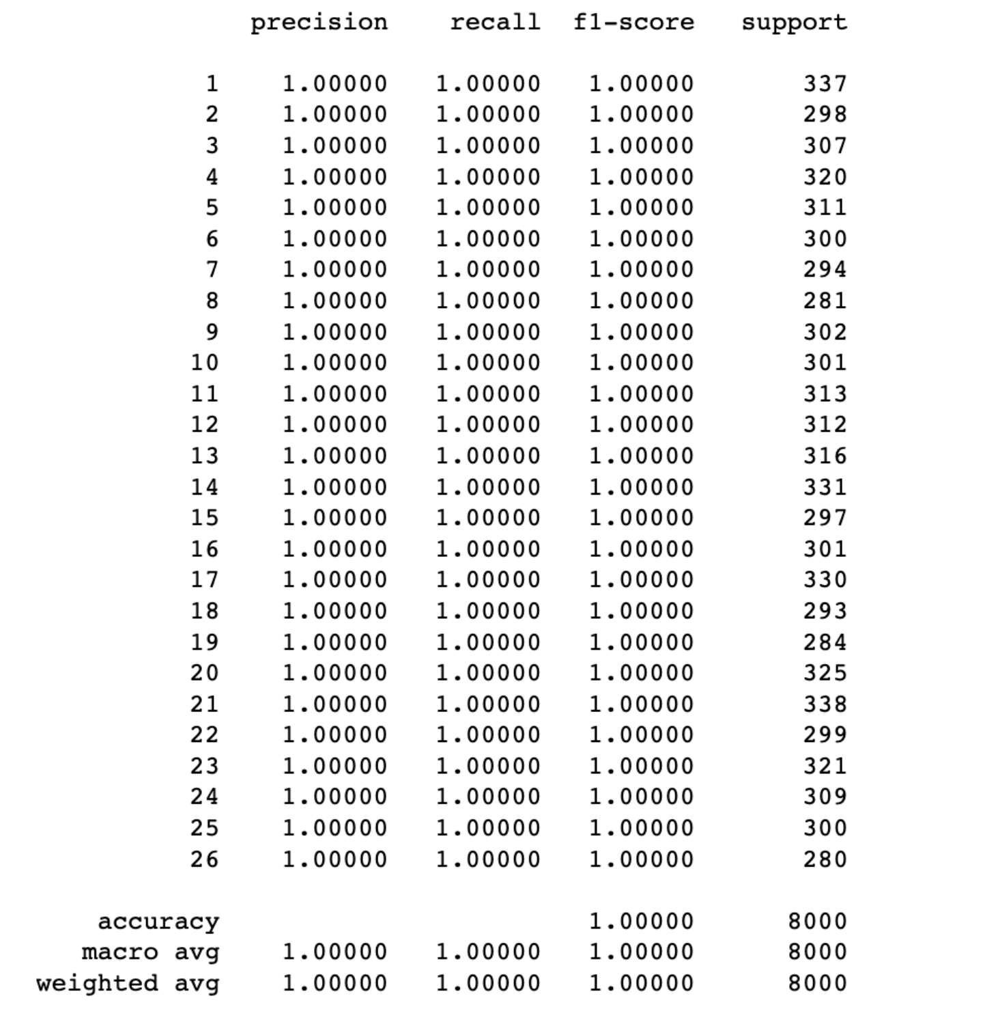
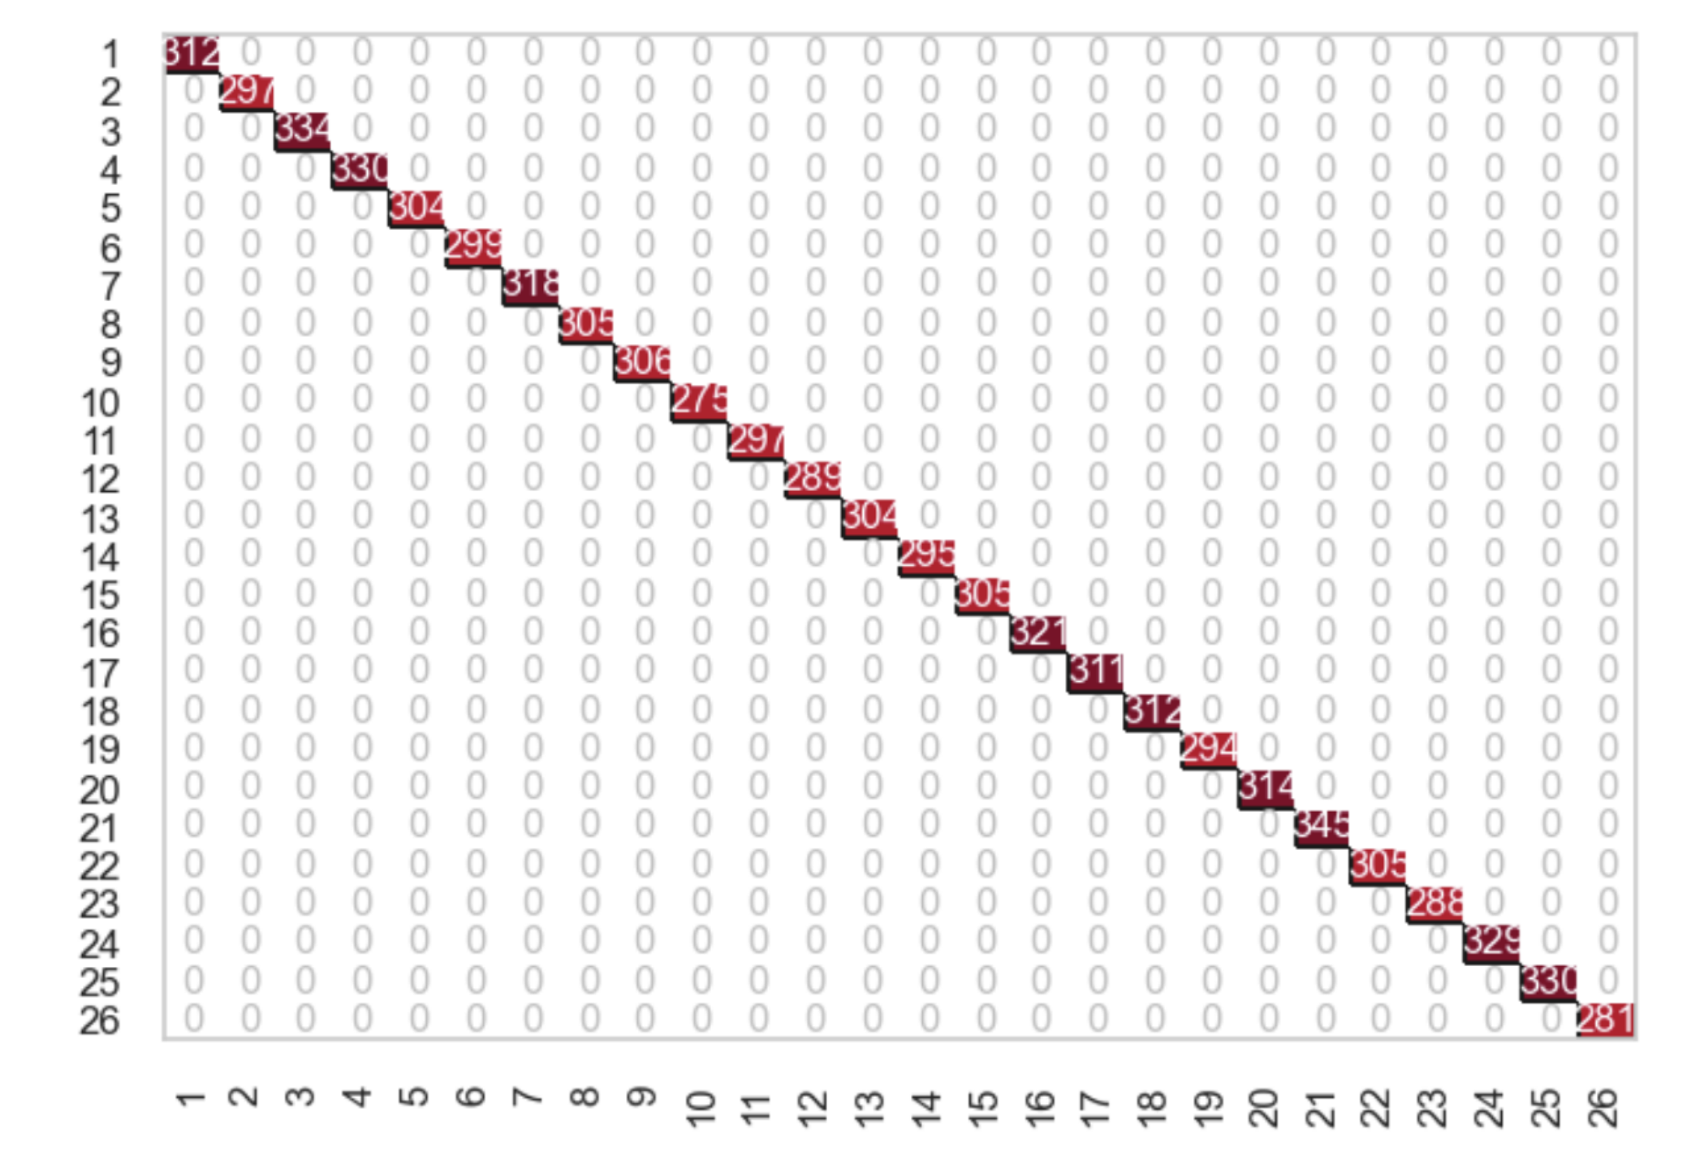
Modeling and Model Evaluation
Decision Tree
Notes:
confusion matrix and classification report

Slide 18
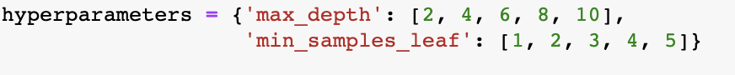
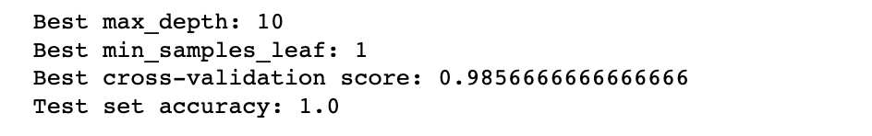
Modeling and Model Evaluation
Decision Tree(hyperparameter tuning)
After that I performed hyperparameter turning to see if there is any difference. I defined the max_depth and min_samples_leaf as below:
We can take a look at the accuracy of Decision Tree model:
This indicates that the accuracy of Decision Tree model is still 1.0, which means it successfully predicts all the letters and it is a perfect model. Therefore, Decision tree performs best.

Slide 19
Modeling and Model Evaluation
KNN
Introduction:
KNN (k-Nearest Neighbors) is a machine learning algorithm for classification and regression problems. It works by finding the k nearest data points in the training set to a given test point, and assigning the test point the class or value that is most common among those neighbors.
In the case of classification problems, the class labels of the k nearest neighbors are used to determine the predicted class of the test point. In regression problems, the average value of the k nearest neighbors is used to predict the value of the test point.
The choice of the parameter k is an important factor in KNN. A small value of k can lead to overfitting, while a large value of k can lead to underfitting. The optimal value of k can be found using techniques such as cross-validation or grid search.

Slide 20
Modeling and Model Evaluation
KNN
Firstly, I split the dataset into training and test sets in a certain proportion (40% for testing, 60% for training). Then I created the KNN Classifier, trained the model using the training dataset and predict the responses for test dataset. Firstly, I used hyperparameter showing as below: n_neighbors=5, metric='manhattan', algorithm='auto', weights='distance'
We can take a look at the accuracy of the KNN model:
This indicates that the accuracy of KNN model is 0.95, which means it has a higher accuracy score than SVC but lower than Decision Tree. We can also check the confusion matrix of the KNN model, it predicts most of the letters, but we can see from the plot that it sometimes predicts the letter incorrectly.

Slide 21
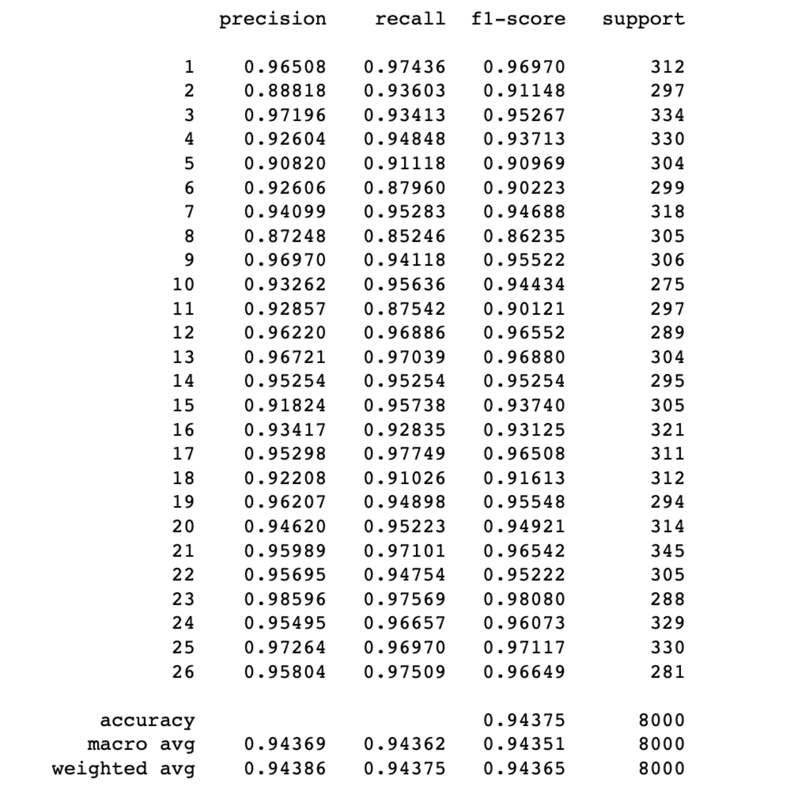
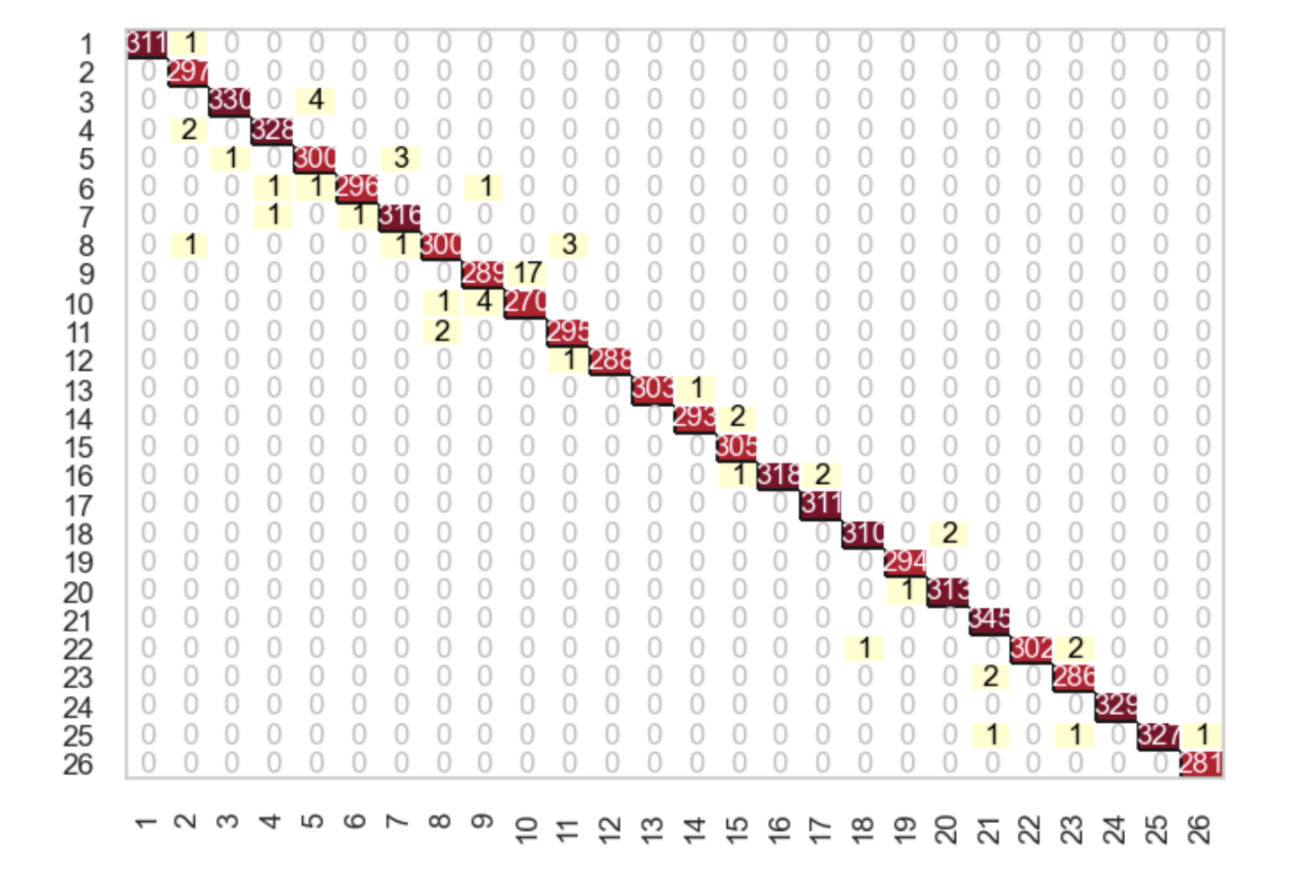
Modeling and Model Evaluation
KNN

Slide 22
Modeling and Model Evaluation
KNN (hyperparameter tuning)
Then I performed hyperparameter tuning to see if there’s any difference. I used hyperparameter showing as below: metric='minkowski', algorithm='ball_tree', weights='uniform'
We can take a look at the accuracy of the KNN model:
This indicates that by performing hyperparameter turning, the accuracy of KNN model is 0.98, which means it’s better than before, but still lower than Decision Tree. We can also check the confusion matrix of the KNN model, it predicts most of the letters, but we can see from the plot that it sometimes predicts the letter incorrectly.

Slide 23
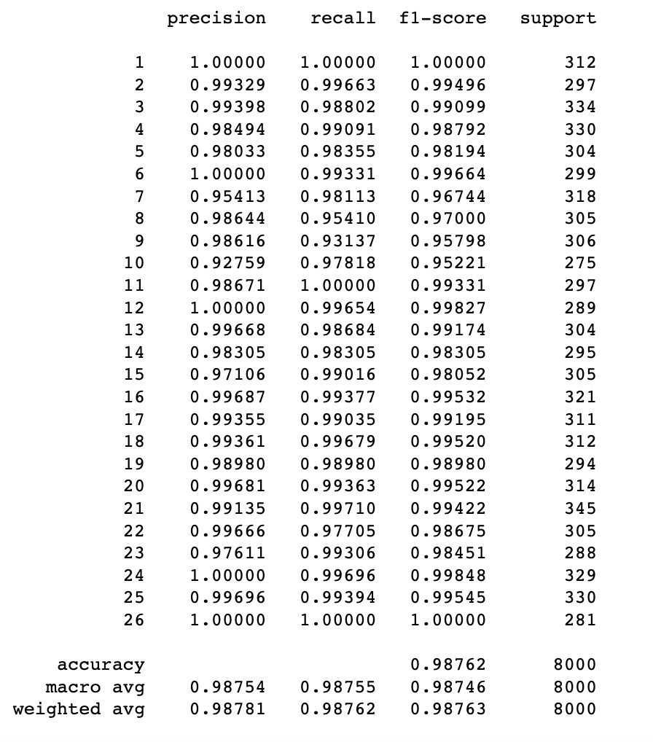
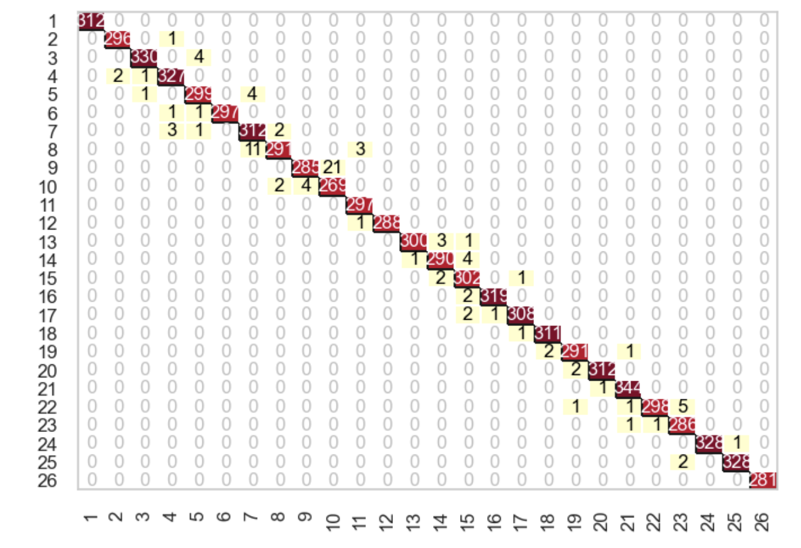
Modeling and Model Evaluation
KNN
Notes:
confusion matrix and classification report

Slide 24
Conclusion
The SVC model has an accuracy score of 0.85, which is lower than the Decision Tree and KNN models. This suggests that the SVC model may not be the best choice for this particular dataset or that it may need further tuning of its hyperparameters. The Decision Tree model has an accuracy score of 1.0, which means it is perfectly able to classify the data points in the given dataset. This is an excellent result, but the model may be overfitting to the training data, and its performance on new, unseen data may not be as good. The KNN model has an accuracy score of 0.95, which is close to perfect accuracy and suggests that the KNN model is performing very well on this dataset.
By using SVC model, Decision Tree model and KNN model to classify the 26 letters, they all have pretty good performance. However, since Decision Tree model has an accuracy score of 1.0, so the best model to predict the 26 letters is Decision Tree model.

Slide 25

Thank you!

